Slide 1

Energy Division, Customer Generation
Joshua Litwin, Regulatory Analyst (DAC-GT & CSGT)
joshua.litwin@cpuc.ca.gov
Cherie Chan, Regulatory Analyst (GTSR)
cherie.chan@cpuc.ca.gov

Slide 2
DAC-GT & CSGT January 2022 Applications for Review
Guidance Template Overview & Discussion
September 15, 2021 9:30AM – 11:30AM

Slide 3


Workshop Logistics
Today's presentation (.pdf) will be sent to all participants afterwards.
The 2022 Applications Guidance Template is available here and on the Solar in DACs webpage under Events.
Please mute yourself when not speaking
Submit questions for speakers in the chat box or raise your hand to be unmuted by staff.
Chat questions will be read aloud by staff
Mute/ Unmute
Participant List
Chat
Audio Options
Leave Meeting
Raise Hand

Slide 4

Workshop Logistics
Online only
  Audio through computer or phone
  1-415-655-0002
  Access code: 2489 562 3796
  This workshop is NOT being recorded
Hosts:
  Energy Division Staff:
    Tory Francisco
    Josh Litwin
    Cherie Chan
    Fang Yu Hu
  Safety
    Note surroundings and emergency exits
    Ergonomic Check

Slide 5
Ground Rules
Workshop is structured to stimulate an honest dialogue and engage different perspectives
Keep comments friendly and respectful
Chat feature is only for Q&A or technical issues. Do not start or respond to sidebar conversations

Slide 6
Agenda
9:30 Introductions + Safety
9:35 Goals/Outcomes of Webinar & Scope of Discussion
9:40 Applications for Review Process
9:45 Proposal to Include GTSR and DAC Programs under "Green Access Programs"
9:50 DAC & GTSR Current Program Status
B R E A K
10:10 DAC-GT & CSGT Major Topics & Discussion
10:40 GTSR Major Topics & Discussion
11:10 Q&A
11:25 Close (We may end earlier)

Slide 7
Goals and Outcomes

Slide 8
Goals and Outcomes of This Webinar
Provide further guidance on the format and content of the January 2022 Applications for Review
Proposal to include GTSR in Applications
Spark discussion among stakeholders before IOUs begin drafting Applications
Identify program issues and topics for inclusion
Answer Program Administrator and stakeholder questions about Applications process

Slide 9
Scope of Today's Discussion

Slide 10
In Scope
Programmatic Challenges
Proposed Changes to Programs
Cost-Benefit Analysis
Are programs meeting stated goals?
Unintended Consequences and Externalities
Procurement Challenges
Out of Scope
Active Petitions for Modification or Advice Letters under CPUC review
Notes:
Opportunity to consider
The guidelines outlined below allow the IOUs to present an assessment of the program performance in the targeted market sector and then propose goals, budgets, design, and delivery such that the programs align delivery of services with the anticipated remaining opportunity. The IOUs should also consider incorporating any relevant data and draft findings of the DAC Program 2021 Independent Evaluation into these Applications, as warranted.

Slide 11
Applications for Review Process

Slide 12
Authority for Applications Process
D.18-06-027 (June 2018) established that each IOU would file an Application for Review for the DAC-GT and CSGT programs by January 1, 2021 (one-year extension granted by Exec. Dir. in Sept 2020). Proceeding(s) initiated by these applications would:
  Include a review of both programs’ costs and benefits;
  Result in revisions to the tariffs, if appropriate
Notes:
We've included this section to level-set where the authority for this process came from and what it entails. Starting with the Commission's 2018 Decision establishing the DAC-GT and CSGT programs.

Slide 13
Authority for Applications Process
Resolution E-4999 (May 2019) identified several items the CPUC may review as part of the Applications:
  Address whether and how to allocate any unused capacity to IOUs or participating CCAs, if reserved CCA capacity remained unutilized after Jan 1, 2021 (now Jan 1, 2022). [10 kW from Valley Clean Energy remains]
  Address any situation(s) in which a CCA expands, or a new CCA launches, in an area where a CSGT project exists or is in development
  Review the DAC Program cost containment thresholds based on relevant cost data which should be available for initial DAC-GT and CSGT project bids
The guidance template and this webinar aim to better communicate what additional information the Applications should include.
Any additional topics from stakeholders can be raised by parties in comments on the Applications early next year.

Slide 14
Green Access Programs (GAP) Proposal

Slide 15
LEGISLATIVE AUTHORITY
GTSR: Expand access to "renewable energy resources to all ratepayers who are currently unable to access the benefits of onsite generation...[and]...create a mechanism whereby institutional customers…commercial customers and groups of individuals . . . can meet their needs with electrical generation from eligible renewable energy resources.“ – SB 43 (Wolk 2014)
DAC-GT & CSGT: Ensure "that customer-sited renewable distributed generation continues to grow sustainably and include specific alternatives designed for growth among residential customers in disadvantaged communities.“ – AB 327 (Perea 2013)
Notes:
SB 43 Recognized that the benefits of onsite solar are not available to 70% of residential and Small Commercial Ratepayers, and also created a 100MW carve-out for small projects in Environmental Justice Communities
During a Similar Timeframe, AB327 required the CPUC to develop a renewable energy rate as a successor to then-existing, extremely popular Net Energy Metering tariffs. As a part of this mandate, AB 327 required the Commission to consider alternatives designed to increase adoption of renewable generation in Disadvantaged Communities.

Slide 16
Green Access Programs (GAP)
Expanding Access Beyond Rooftop Solar
 | Green Tariff | Enhanced Community Renewables | Disadvantaged Communities – Green Tariff | Community Solar Green Tariff (CSGT)
Concept | 100% renewables w/o: contract, commitment, roof | Multiple subscribers share the output of a single project | Similar to Green Tariff but at a 20% discounted rate | Local community solar at a 20% discounted rate
Energy Source | Pool of renewables projects | A designated local project | Pool of renewables projects | A designated local project
Customer Purchase | 50%-100% of customer’s historical monthly usage | kWh production of customer’s subscribed portion of project | 100% of customer’s historical monthly energy usage | kWh production of customer’s subscribed portion of the project
Transaction | IOU bills customer | Agreement between developer and customer; IOU bills customer | IOU bills customer | Agreement between IOU and developer; IOU bills customer
Enabling Legislation | Senate Bill (SB) 43 |  | Assembly Bill (AB) 327 (Perea, 2013); Includes DAC-SASH
Expiration | When 600 MW capacity procured and enrolled: participants can remain 20+ years |  | When 199 MW capacity procured and enrolled; DAC-GT is 20 years, CSGT is term of project

Slide 17
GAP Rationale
Bridge the solar access "GAP" for customers with structural, financial, and other barriers.
Increases regulatory and administrative efficiencies
Similarities in program design and cross-cutting issues between the market-rate seminal (GTSR) and targeted low-income (DAC-GT & CSGT) Green Access Programs.
  DAC-GT is modeled after the Green Tariff portion of the Green Tariff/Shared Renewables Programs
  CS-GT program is structured after the Enhanced Community Renewables (ECR) portion of the GTSR program.
Reforms to the DAC-GT and CSGT programs could be considered wholistically.
Notes:
To encourage consistency and efficiency, we encourage the IOUs to address Green Tariff Shared Renewables (GTSR) program issues in these applications.
The CPUC based portions of DAC-GT and CSGT program design on the two GTSR programs, Green Tariff and Enhanced Community Renewables, respectively. There are sufficient similarities and cross-cutting issues to warrant the evaluation of both, together.
DAC-GT is modeled after the Green Tariff portion of the Green Tariff/Shared Renewables Programs adopted in D.15-01-051
CS-GT program is structured after the Enhanced Community Renewables (ECR) portion of the GTSR program.
GTSR remains without a procedural "home".
Though the GTSR program was originally scheduled to sunset on January 1, 2019, the Commission ultimately issued Resolution E-5028 on September 30, 2019, which extended the GTSR program indefinitely until the 600 MW cap was reached. That Resolution found that while they had merit, modifications proposed in comments would result in a “different structure or materially different capacity” to the program. Thus, these were found to be beyond the scope of the Advice Letter process and would require a more formal review, as initiated in a Petition for Modification or Application.

Slide 18
Program Status

Slide 19
DAC-GT Program Status
12 Program Administators (3 IOUs & 9 CCAs)
14,000+ enrolled residential customers using interim GT or RPS resources (PG&E and Clean Power Alliance)
10 kW of reserved capcity for Valley Clean Energy remains unclaimed
~23% of available 158MW capacity has been procured

Slide 20
CSGT Program Status
8 Program Administators (3 IOUs & 5 CCAs)
No enrolled residential customers until new projects are built
All reserved capacity claimed
~32% of available 41MW capacity has been procured

Slide 21


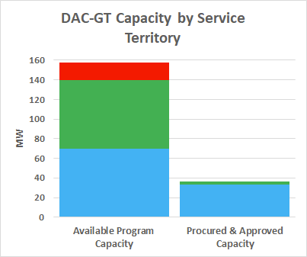
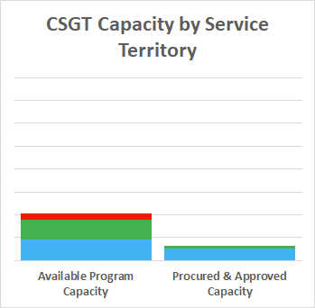
DAC Procurement Status
*Approved capacity based on PG&E ALs 5996-E & 6229-E; SCE AL 4297
Notes:
There's almost 200MW of capacity allocated among the two programs. 158MW for DAC DG (70MW for PG&E territory, 70MW for SCE territory, 18MW for SDG&E territory). Another 41MW for CSGT (18MW PG&E, 18MW SCE, 5MW for SDG&E territories). Capacity was split within each territory according to the percentage of bundled vs. unbundled (IOU vs. CCA) residential customers in DACs.
The IOUs have run 3 Requests for Offers so far since launching early last year. Due to differing program launch timelines, the CCAs have either already held their first RFO or are preparing to launch.
For various reasons, successful bids have lagged in SCE and SDG&E territories – the 2021 Independent evaluation will be surveying solar developers, program administrators, and other stakeholders to better understand the geographic and procurement challenges to reaching full procurement. The initial results and findings should be included in these Applications.

Slide 22
GTSR Program Status
3 IOU Program Administrators
162 new MW of Renewables Procured so far
98 MW of reserved Environmental Justice capacity remains unclaimed
74% of available 600 MW capacity has been procured
Notes:
The CCAs also have similar programs, but because they do not receive ratepayer funds in this case, the CPUC does not have direct jurisdiction over these funds.

Slide 23
GTSR Program Status: Reaching the 600 MW Cap
74% of Available Capacity Remains
Notes:
From Quarterly Reports dated July 2021
Discuss PG&E’s increasing GT Enrollment, SDG&E’s Decreasing GTSR Enrollment from CCAs
So, as we discussed 600 MW of new incremental Renewable Capacity was imagined by GTSR, the bar to the left.
Of those, we have signed 153 MW of incremental, New power purchase agreements to supply Green Tariff customers so far.

Slide 24
GTSR Program Status: Quarterly Reports by Utility
Notes:
From Quarterly Reports dated July 2021
Discuss PG&E’s increasing GT Enrollment, SDG&E’s Decreasing GTSR Enrollment from CCAs

Slide 25

Stretch Break
Image Source: iamthinks.blogspot.com
Notes:
Let’s come back in 10 minutes

Slide 26
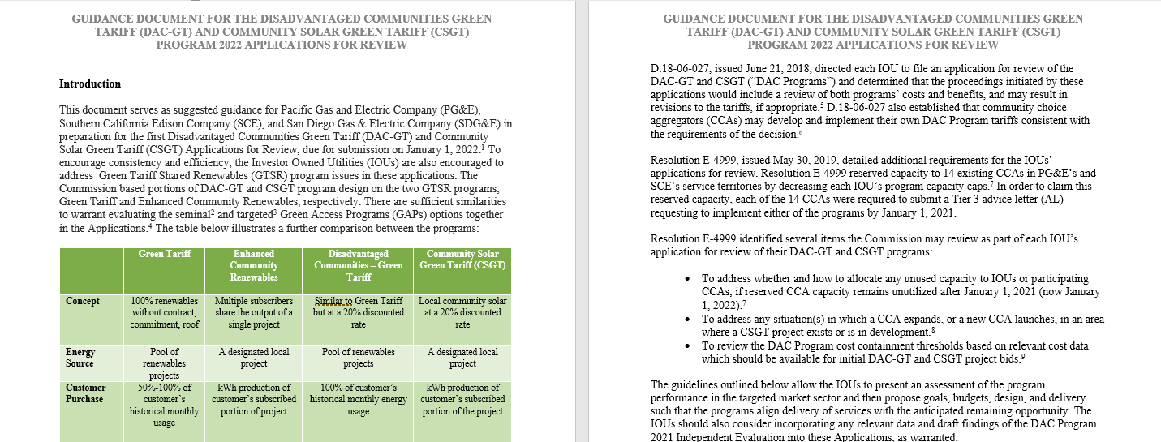
Guidance Template
https://www.cpuc.ca.gov/-/media/cpuc-website/divisions/energy-division/documents/solar-in-disadvantaged-communities/2022-gap-applications-guidance-template.pdf
Notes:
The 2nd half of our webinar will be dedicated to the Applications Guidance Template and a discussion on the topics included. For those of you who aren't familiar, the template was sent out with the invite to service list and can also be download from this link at the bottom of the slide. Its purpose is to provide a uniform template for the IOUs and to suggest additional topics for inclusion in the Applications. We will not go over this entire template today, but rather use the webinar to discuss a few of the major topics, then allow participants/stakeholders to propose topics that they would like to see included.

Slide 27
DAC-GT & CSGT Topics

Slide 28
DAC-GT & CSGT Major Topics
2021 Independent Evaluation - topics from PA Interviews:
  Connecting: CBO/community sponsors with solar developers
  Procurement challenges: size, siting, and interconnection
  Marketing & outreach: how to connect CBOs and community sponsors
  Workforce development: how to track training, etc.
  Environmental/GHG benefits: how to accurately market and report
  CCA expansion: whether/how to reallocate capacity
  Geographic eligibility: whether/how to include low-income customers in tribal or other areas
Uniform budget template: For use in February Annual Budget Advice Letters and to track funding sources (GHG & PPP)
Notes:
Some topics from guidance template pasted here for consideration

Slide 29
What Additional Topics Would You Like Included?
Technologies
  MCE: Consideration of solar resources, and whether they can be shared with storage in RFOs moving forward.
General Goal-Setting
  Evergreen Economics has shared Logic Models, Program Outcomes, and Metrics, which ultimately link back to Program Goals
  Draft 2021 Independent Evaluation Report is still on schedule and should be included in Applications.
Clarifying and Coordinating Timelines
  DAC-GT: CCAs are noting that they have launched projects with interim resources. While they don’t show up in reporting, CCA DAC-GT programs are effectively full: Construction is just catching up to procurement, which is catching up to enrollment.
  CSGT: These are still open opportunities which remain largely unfulfilled. Pre-Enrollment or auto-Enrollment to enhance low-income enrollment to meet 25% threshold should be considered.
Procedural Discussion
  IOUs are DIRECTED to file Applications. CCAs may file.
  If only IOUs file applications by Jan 2022, CCAs can add comments on the record. CCAs are generally aligned with comments noted so far, aside from CCA expansion. Having CCAs engage on the IOU applications could be the most efficient mechanism for consideration.
  Suggestion on CCA Expansion: Stakeholders (CCAs and IOUs) may schedule some offline collaboration in advance of the Applications. This may also need to be coordinated with upcoming DAC Billing Workshop and GTSR Developers Forum.
Notes:
Point is to identify the topics rather than get into merits
This slide is to ask what stakeholders would like to see included and take notes
Idea here is to capture suggestions and feedback; we'll include in final slide and send out to participants/post on Solar in DACs website
If utilities don’t agree with and include proposed topics in their Applications, stakeholders can file comments or protest

Slide 30
GTSR Topics

Slide 31
GTSR Major Topics
    PCIA: Consider whether the cost-effectiveness proxy (currently the Power Charge Indifference Adjustment PCIA) might be updated or not, and present options to do so.
Branding: Coalescing program branding may reduce Marketing, Education and Outreach (ME&O) costs and limit customer confusion.
Access: How to enhance participation and eligibility for the 100 MW DAC reservation? How might the 1 MW cap hinder project adoption in Environmental Justice (EJ) communities?
    Community Interest: Streamlining or adopting a way of demonstrating community interest and enrolling customers.
    Reporting and Metrics: Propose reporting requirements and Key Performance Indicators (KPIs) or metrics to measure program effectiveness.

Slide 32
What Additional Topics Would You Like Included?
Incorporate storage into community-based renewables programs – what steps should there be for consideration?
Environmental/GHG benefits: how to accurately market and report
Ratepayer indifference constraints
Setting aside capacity for Community Renewables so that Green Tariff rate options don’t take up all the capacity (also leaves IOUs with all the financial risk) – strong support from CCSA, as Community Renewables remains highly undersubscribed.
Template Questions:
  Question about schedule: Section G included a typo and does not need to be included.
  What is included in the Guidance Template is a recommendation, not a requirement.
    The minimum information required is what is in the Decisions and Resolution 4999-E.
    We recognize that the template goes beyond the minimum required, but Energy Division would like provide additional guidance and help ensure that this process is robust and addresses pressing issues.
SCE and SDG&E: Changes you are looking for would need to be initiated on the legislative end.
  SDG&E is experiencing high attrition because the rate is increasing very quickly due to CCA attrition (spiral). Fixes which would be needed to be put in place require legislative changes. Long-term stranded cost issues.
  SCE – 2 MW Per-Customer Cap - businesses want to be 100% green, and there is no way to fulfill this on their end given this legislative requirement.
Notes:
Point is to identify the topics rather than get into merits
Use topics from guidance template
Another slide for what stakeholders would like to see included
Capture suggestions and feedback; include in slide and send out to participants and post on website
If utilities don’t agree, stakeholders can file comments or protest

Slide 33

Q&A
Reminder:
Please submit questions/comments via the WebEx chat and/or
use the “raise hand” function.
Image Source: netclipart.com

Slide 34
For more information:
joshua.litwin@cpuc.ca.gov
www.cpuc.ca.gov/SolarInDACs
cherie.chan@cpuc.ca.gov
www.cpuc.ca.gov/GTSR
Notes:
Thank you!

